Slide 1

FIN 557
Evaluation of IPOs and Market Performance
Group 14
Akshaya Suresh, Chubo Wen, Preethi Peelamedu Surendran, Purva Vaswani, Vishwas Rao, Xingyu Chen, Yu Bai, Ziqian Ding

Slide 2

Introduction
01

Slide 3
Introduction
Introduction
Our analysis examines Initial Public Offerings (IPOs) and their impact on market performance, aiming to understand sector trends, identify top-performing companies, and uncover correlations between IPO variables and post-IPO market performance. Through structured data analysis, significant sectoral variations in IPO prices were observed, Teladoc emerged as a standout performer, and regression analysis highlighted key factors influencing post-IPO market performance.

Slide 4

02
Data Management

Slide 5

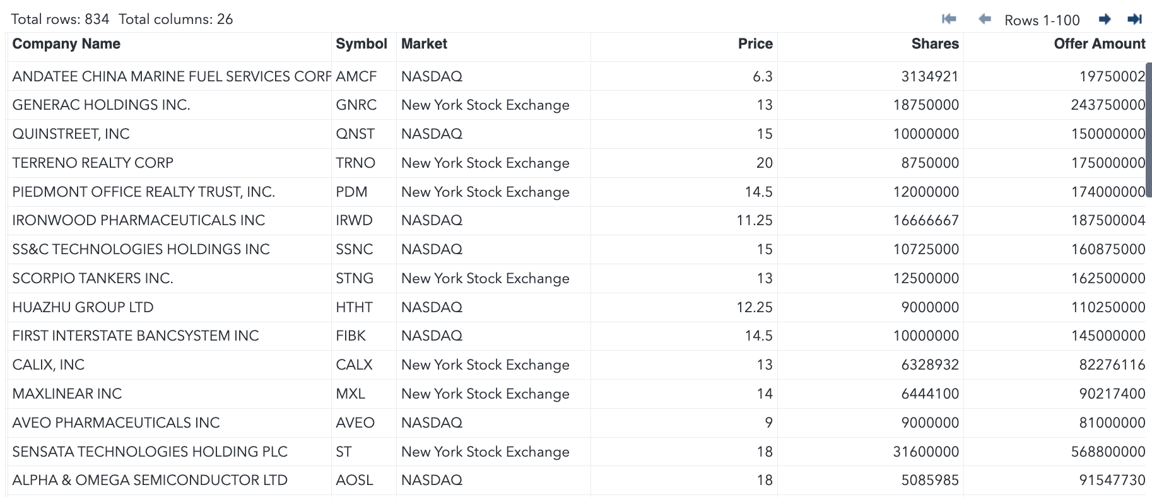
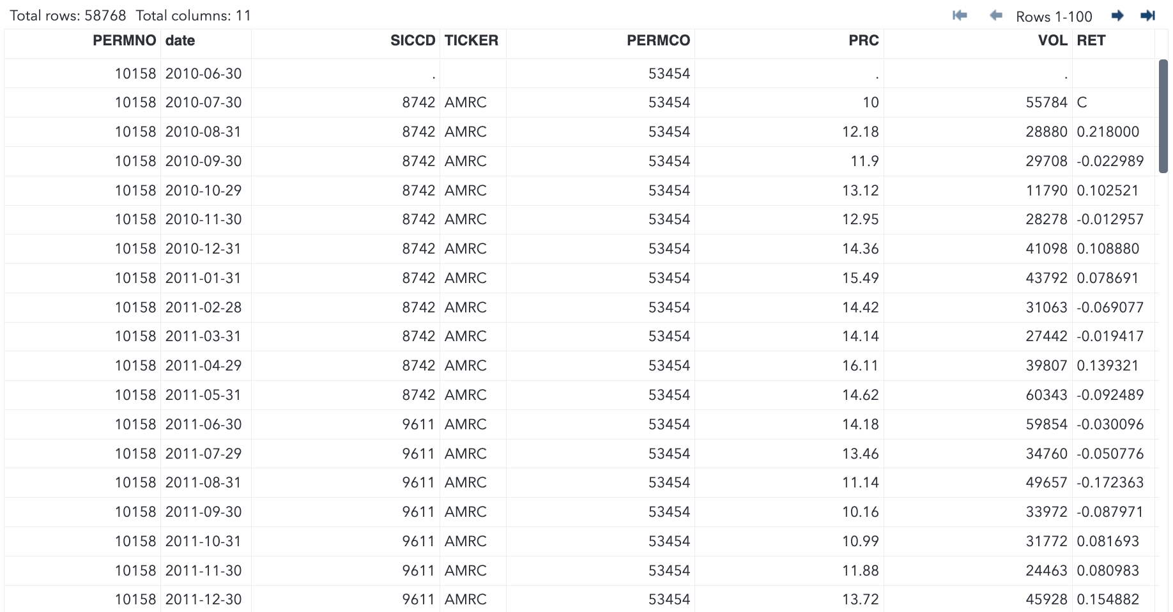
Mission statement
2) Data Management
Downloaded a dataset of Company IPOs Over Time from Kaggle.
Downloaded a corresponding dataset containing financial information of these companies from WRDS.

Slide 6
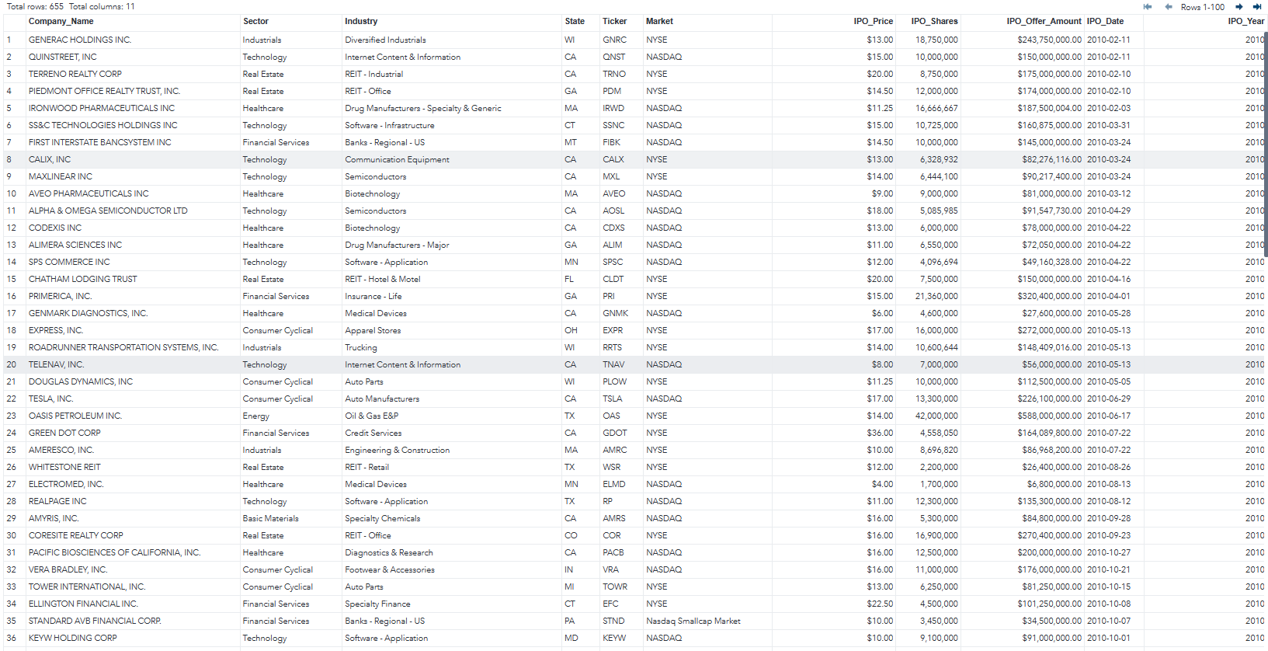
Mission statement
2) Data Management - Step One
Established a new dataset, proj.ipo_kaggle_data_clean, retaining specific columns and ordering them for clarity.
Formatted IPO_Price, IPO_Shares and IPO_Offer_Amount for readability.
Consolidated variants of Market names into just NASDAQ and NYSE.
Derived IPO_Year column from IPO_Date to facilitate analysis.
Removed rows with missing State values to keep only US companies.
The processed dataset, proj.ipo_kaggle_data_clean, contains cleaned and organized IPO data, suitable for further analysis, sorted by IPO_Year.

Slide 7
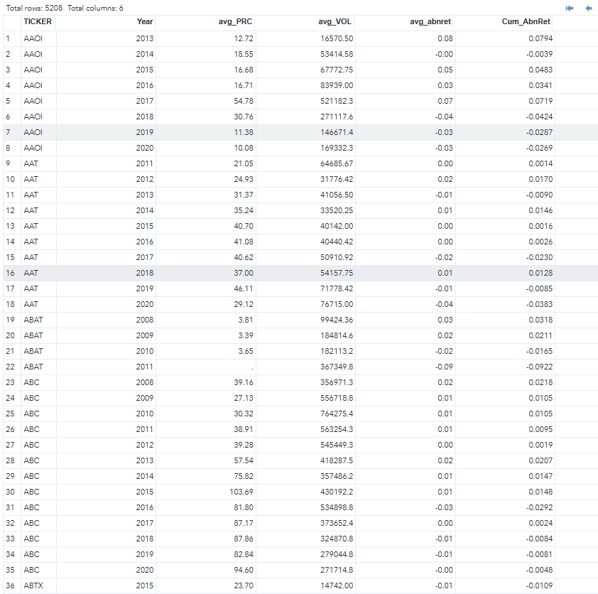
Mission statement
2) Data Management - Step Two
Focused on records with valid Tickers between 2008 and 2020 and sorted data by Ticker and Year.
Derived new columns from date variable to extract Year, Month and Day.
Calculated abnormal return (abnret) as the difference between RET and vwretd.
Computed and formatted yearly averages for metrics like average price, volume, and abnormal return.
Calculated cumulative abnormal returns (Cum_AbnRet) in the final dataset, proj.cum_stock, by accumulating average abnormal returns for each year. The cumulative sum is reset at the start of each Ticker.

Slide 8
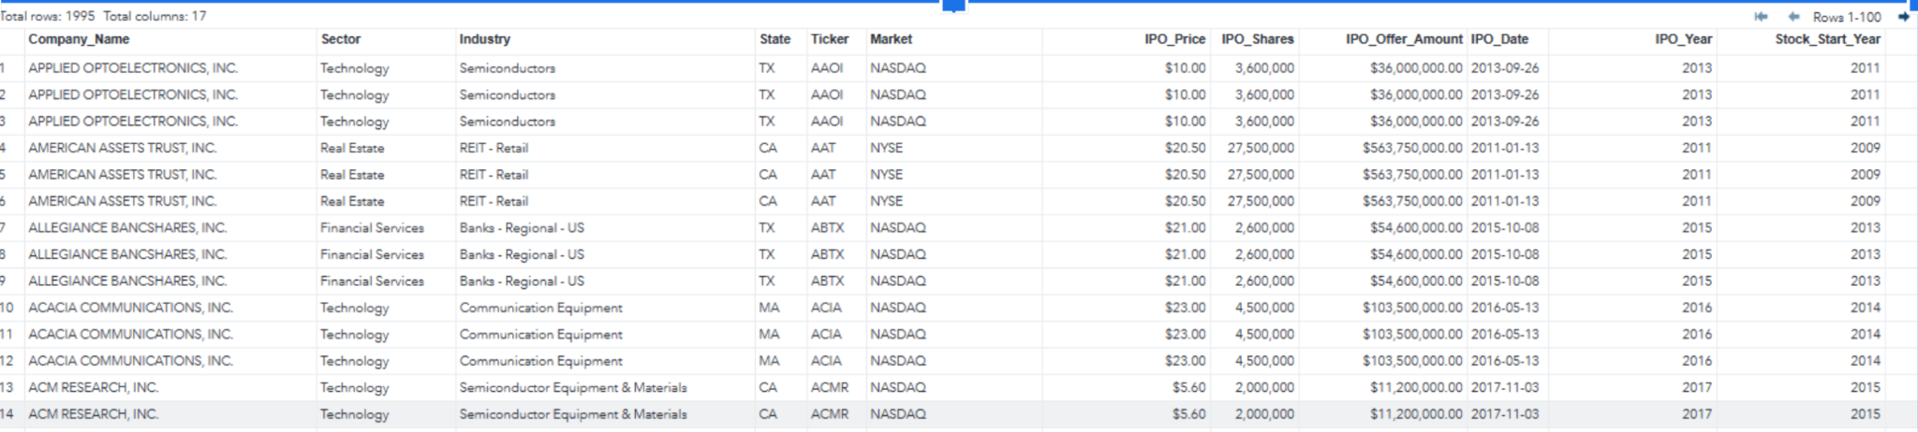
Mission statement
2) Data Management - Step Three
Merged data by performing a left join on proj.ipo_kaggle_data_clean (the IPO dataset) and proj.cum_stock (the stock dataset).
Join was based on the Ticker column and included stock data from the IPO_year to five years after.
Merged dataset final_merged_data contains information from both the IPO and stock data, including company details, financial metrics, and cumulative stock returns.

Slide 9

Regression
03

Slide 10
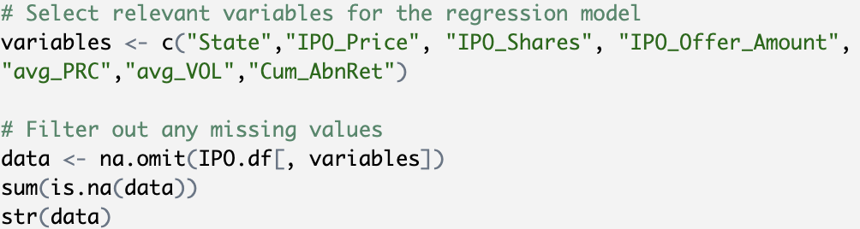
Regression - Step One
Subset of relevant variables chosen for regression model: state, IPO price, number of IPO shares, IPO issue amount, average price, average trading volume, and cumulative abnormal returns.
Removal of missing values from selected variables.

Slide 11
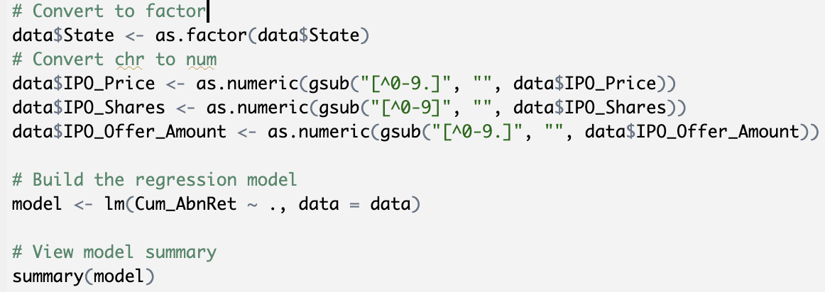
Regression - Step Two
Conversion of variable "State" to a factor.
Conversion of character variables (IPO_Price, IPO_Shares, IPO_Offer_Amount) to numeric format.
Linear regression model built using lm() function to analyze the effect of different variables on Cum_abnret.

Slide 12
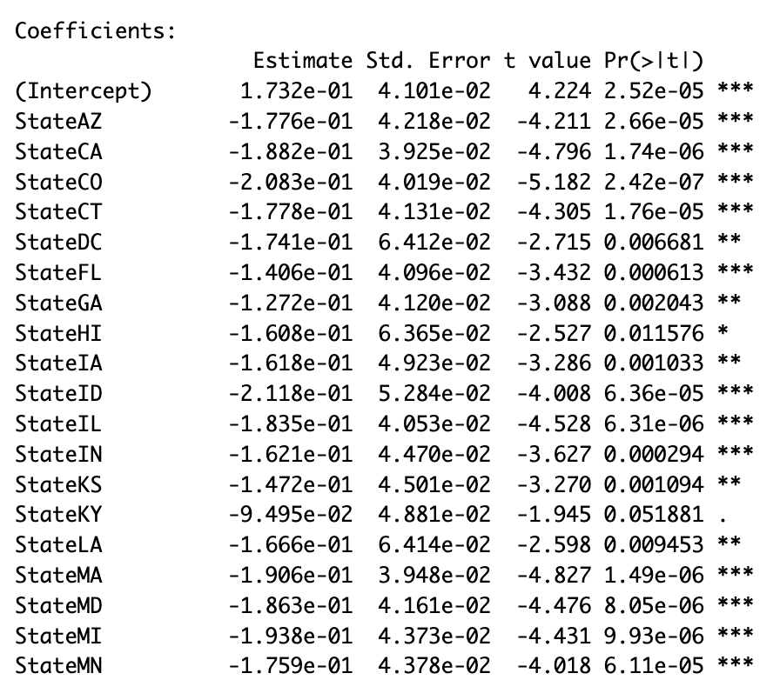
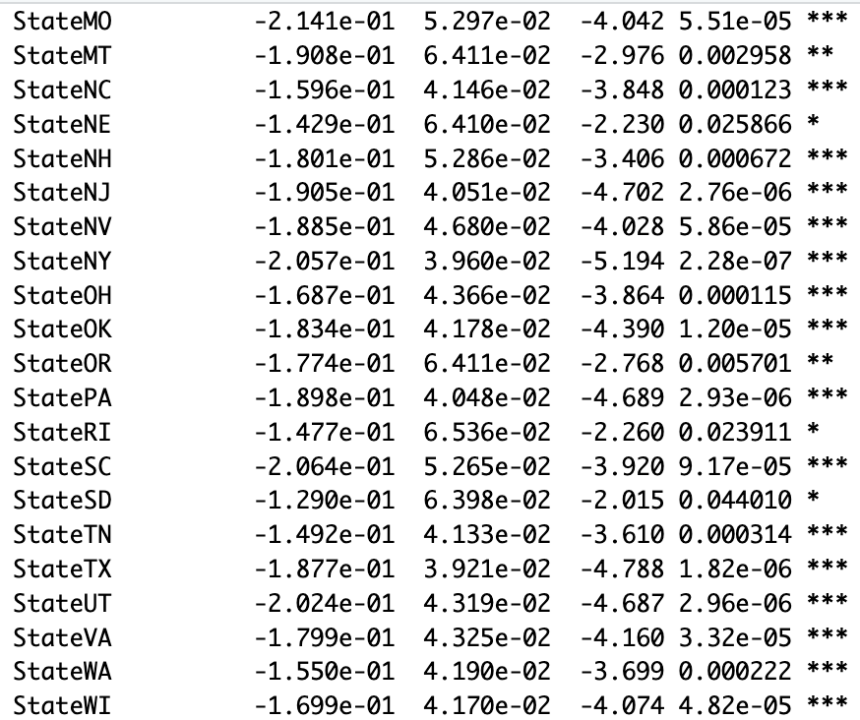
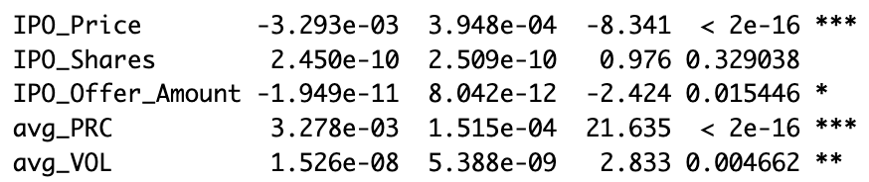

Regression Analysis
“***” : p<0.001
“**” : p<0.01
“*” : p<0.05
no stars : not statistically significant
Only variables “StateKY” and “IPO_Shares” are not statistically significant (p-value>0.05)
“avg_PRC” , “avg_VOL” : coefficients>0 & p<0.01
Higher average prices and trading volumes tend to be linked with increased returns, pointing toward stronger market trends or greater investor engagement.
“IPO_Price” , “IPO_Offer_Amount” : coefficients<0 & p<0.05
In certain states, along with higher IPO prices and offer amounts, are associated with lower returns

Slide 13
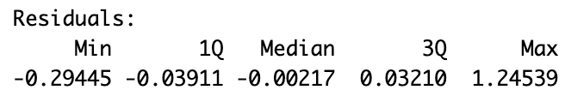
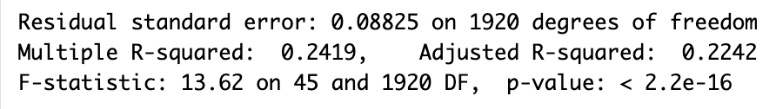
Regression Analysis
Problem
Model Validity
$20,000
This regression model has poor fitting ability
It might be caused by the non-linear relationship between some of the variables
The max residual is relatively large which might indicate that there are some outliers.
p< 0.001 :
this model is still significant and reasonable
40%

Slide 14

Data
Analysis
04

Slide 15
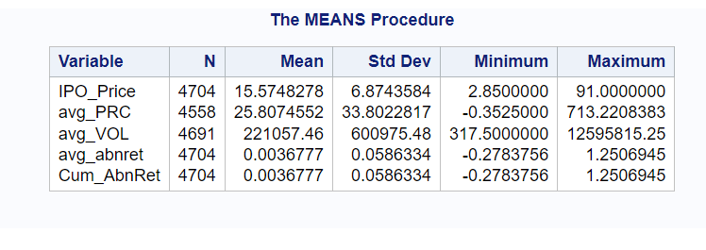
Mission statement
2) Data Analysis - Step One
Evaluated the average stock price for these companies in 2020 to assess 5-year stock price changes.
Used PROC MEANS procedure to calculate summary statistics for variables from the merged_dataset.
Computed count (N), mean, standard deviation (stddev), minimum, and maximum values for IPO_Price, avg_PRC, avg_VOL, avg_abnret, and Cum_AbnRet.

Slide 16
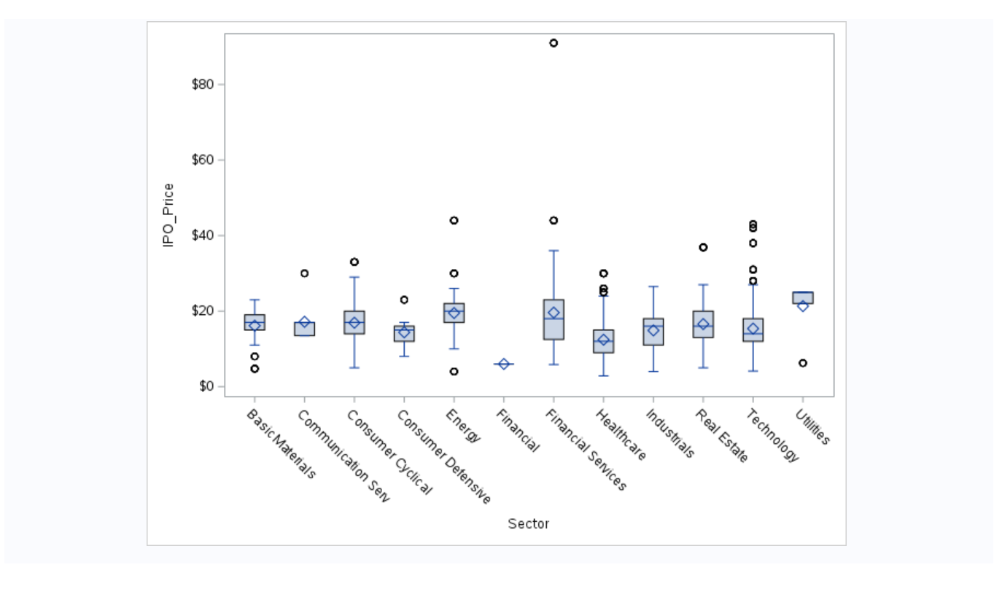
Mission statement
2) Data Analysis - Step Two
Conducted ANOVA test to assess statistically significant differences in IPO prices across various sectors or industries.
Utilized PROC SGPlot procedure to generate a vertical box plot (vbox) using the dataset.
Created a box plot of IPO_Price grouped by the variable Sector to visualize distribution across sectors.

Slide 17
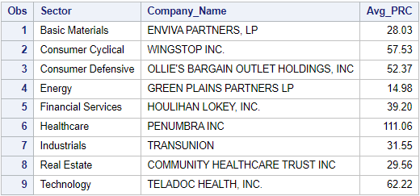
Mission statement
2) Data Analysis - Step Three
Calculated average price (avg_PRC) for each company within every sector using the filtered dataset.
Sorted dataset by sector and average price in descending order to determine top company in each sector.
Eliminated initial row of data for each sector to ensure data integrity and avoid redundancy.

Slide 18
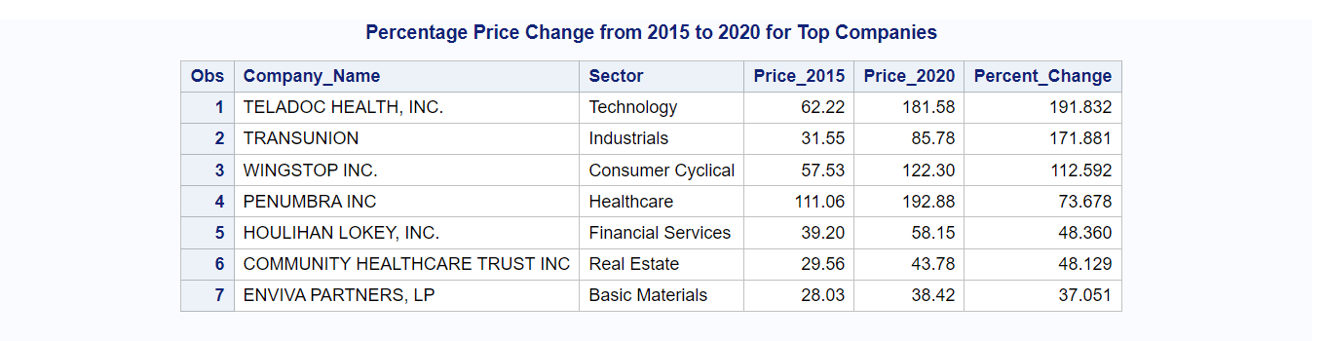
Mission statement
2) Data Analysis - Step Four
Extracted data from the dataset, filtering for records from 2020.
Narrowed down selection to specific companies using their tickers such as 'PEN', 'EVA', 'WING', 'GPRE', 'HLI', 'TRU', 'CHCT', 'TDOC', and 'OLLI'.
Retained variables Sector, Company_Name, and Avg_PRC for analysis.

Slide 19
Mission statement
2) Data Analysis - Step Five
Merged datasets based on Company_Name and Sector using PROC SQL to create new dataset named price_comparison.
Combined company price information from 2015 and 2020 in price_comparison dataset.
Calculated percentage change for each company's stock price over 5-year period by computing difference between prices in 2015 and 2020.

Slide 20

05
Conclusion

Slide 21
Introduction
Conclusion
The report delves into IPO intricacies and their impact on market performance. Through thorough data analysis, it uncovers sector trends, top-performing companies like Teladoc, and the link between IPO variables and cumulative abnormal returns. Understanding IPO dynamics is crucial for informed decision-making in finance.

Slide 22

Thanks!

Slide 23

Data Management:
Preethi Peelamedu Surendran & Akshaya Suresh
Data Analysis (Summary Statistics, etc):
Purva Vaswani & Vishwas Rao
Regression Model and Analysis:
Ziqian Ding & Yu Bai
Report and Powerpoint Slides:
Xingyu Chen & Chubo Wen

